Slide 1
Flaunt Website
R2: Iteration 4
Use Case Diagrams

Slide 2
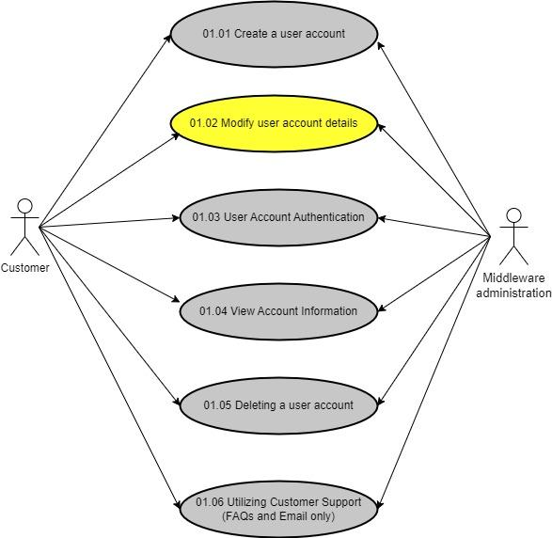
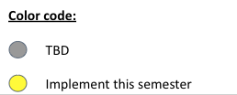
Flaunt Website
Module 01: Account Details
UC 01.02 Modify User Account
Use Case Diagram
Customer is Registered User

Slide 3
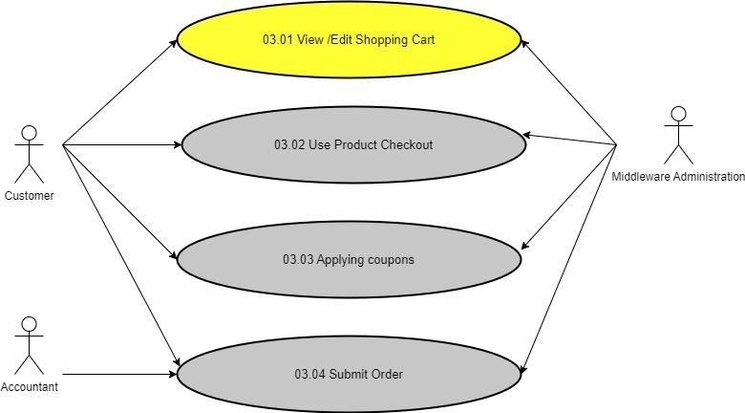
Flaunt Website
Module 03: Purchase Management
UC 03.01 View/Edit Shopping Cart
Use Case Diagram
Customer is Registered User

Slide 4
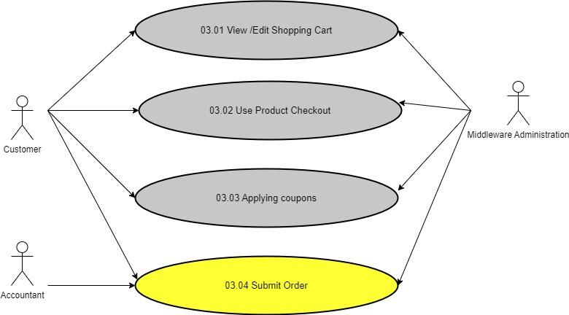
Flaunt Website
Module 03: Purchase Management
UC 03.04 Submit Order
Use Case Diagram
Customer is Registered User

Slide 5
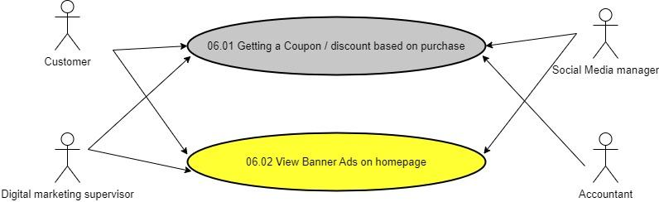
Flaunt Website
Module 06: Advertising Media
UC 06.02 View Banner Ads Homepage
Use Case Diagram
Customer is Registered User

